Slide 1
Java Transaction Design Strategies
2016-04-26
By Shengli

Slide 2
3 Transaction Models
Local Transaction Model
Manage connections
Programmatic Transaction Model
Manage transactions
Declarative Transaction Model

Slide 3
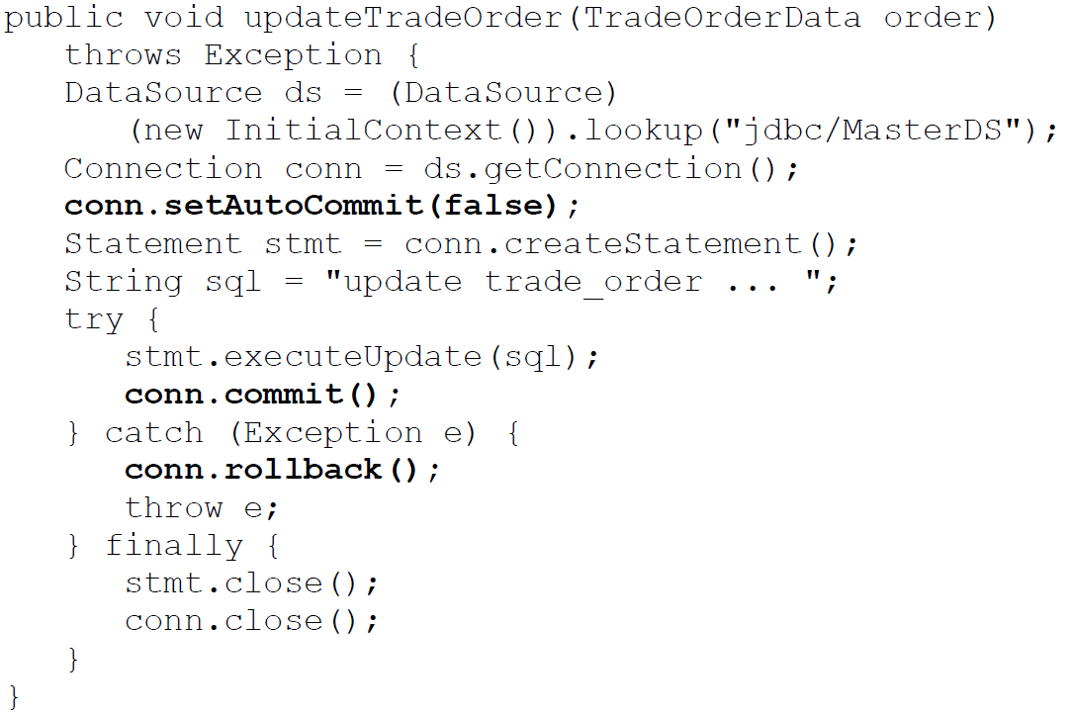
Local Transaction Model
Transaction management is handled by:
The underlying Database (DBMS)
The underlying messaging provider (For JMS)
Limitation
Easy to be wrong
Cannot support XA

Slide 4
Programmatic Transaction Model
Javax.transaction.UserTransaction
Manage transactions
Pay close attention to exception handling
Transaction Context Problem
Pass a transaction context from one bean using programmatic transactions into another bean using programmatic transitions
Use Case: Client-initiated transactions
The client makes multiple remote calls for a single business request
Programmatic transactions on client; declarative transactions on remote EJBs
Use Case: Localized JTA transactions
For performance reason
Difficult to do with declarative transactions due to the lack of control of when the transaction start or terminate
Long-running JTA Transactions
Start a transaction in one Stateful SessionBean method and terminate it in a different Stateful SessionBean method
Poor Design

Slide 5
Require traction control outside of the container
Load the application-server specific TransactionManagerFactory class
Class txnClass =
Class.forName(“com.ibm.ejs.jts.jta.TransactionManageFactory”)
Get TransactionManager by using reflection
TransactionManager txnMgr =
(TransactionManager) txnClass.getMethod(“getTransactionManager”, null)
.invoke(null, null);

Slide 6
Declarative Transaction Model
Container-Managed Transactions (CMT)
Transaction Attribute
Required (PROPAGATION_REQUIRED in Spring)
Transaction is needed; if there is no, create new one
Mandatory (PROPAGATION_MANDATORY in Spring)
Transaction is needed; if there is no, throw a exception
RequiresNew (PROPAGATION_REQUIRES_NEW in Spring)
Create a new transaction anyway
Supports (PROPAGATION_SUPPORTS in Spring)
Transaction is not mandatory; will be used if there is
NotSupported (PROPAGATION_NOT_SUPPORTED in Spring)
Transaction is not mandatory; will be suspended if there is
Never (PROPAGATION_NEVER in Spring)
Method cannot be invoked with a transaction
In EJB spec
Entity Beans: Required, Mandatory, RequiresNew
Message Driven Beans: Required, NotSupported
Beans implemented Synchronization: Required, Mandatory, RequiresNew

Slide 7
Sample for Supports & NotSupported
Assumption: Maximum 1 million shares a day for one trader
If Supports
Total shares traded so far 900,000
Start transaction
Trader enters a trade for 200,000 shares
Query total shares, result = 1,100,000
Exception thrown. Transaction rollback
If NotSupported
Total shares traded so far 900,000
Start transaction
Trader enters a trade for 200,000 shares
Query total shares, result = 900,000
Trade allowed. Transaction committed

Slide 8
Exception handling and setRollback()
The container will NOT mark the transaction for rollback on an application exception
setRollbackOnly()
Best Practice: Only the method that started the transaction should invoke the setRollbackOnly() method
Simple component responsibility
Method setRollbackOnly() cannot be reversed
Throw java.lang.IllegalStateException if business method annotated by Supports/NotSpported/Never when invoke setRollbackOnly()
@ApplicationException(rollback=true)
Will be ignore if there is no transaction
RuntimeException: javax.ejb.EJBException
Disadvantage: lost information

Slide 9
Transaction Isolation Level
It determines the visibility of updates a transaction will allow when other transactions are accessing and updating the same data
Configured in DBMS / EJB / Spring, effect on both application and database
Concurrency ←→ Consistency
Four Primary Isolation Levels:
TransactionReadUncommitted
Read non-committed updates made by other transactions
TransactionReadCommitted
Hides non-committed updates made by other transactions
Default isolation setting
TransactionRepeatableRead
Same set of values will be read every time the select statement is executed in one transaction
Both read and write locks are placed on the data being queried and modified
TransactionSerializable
Lowest level supported by Java
Only one transaction is allowed access to the data at a time

Slide 10
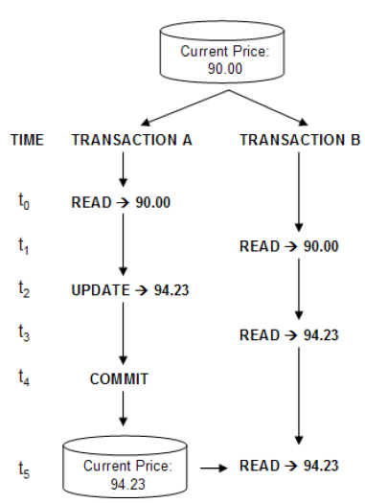
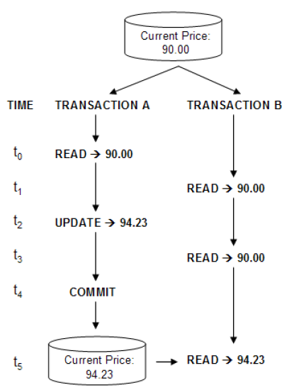
TransactionReadUncommitted
TransactionReadCommitted

Slide 11
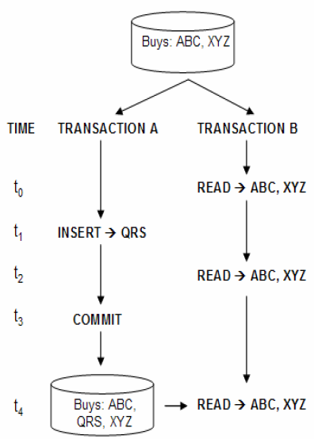
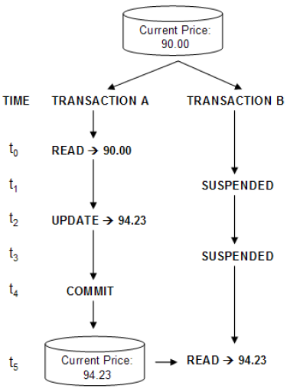
TransactionRepeatableRead
TransactionSerializable

Slide 12
XA Transaction Processing
XA(eXtended Architecture) Transaction
Two-Phase Commit
The Prepare Phase and the Commit Phase
Multi-thread the polling process in Phase 1 and commit process in Phase 2
Last Participant Support
AKA. Last Resource Commit Optimization
Allows a resource that not under XA to participate in the global transaction
A request will be sent to the non-XA participant once the results (ready or not ready) from XA participants are returned and tallied the transaction manager; the outcome will direct the rest of the two-phase commit process
One-Phase Commit Optimization
Phase one will be bypassed

Slide 13
Heuristic Exception Processing
Only occur under XA during the two-phase commit process
The source of the problem
Transaction timeout
Resource locking
Resource overloading
Network latency or network problems
JTA Heuristic Exceptions
HeuristicRollbackException
HeuristicCommitException
HeuristicMixedException

Slide 14
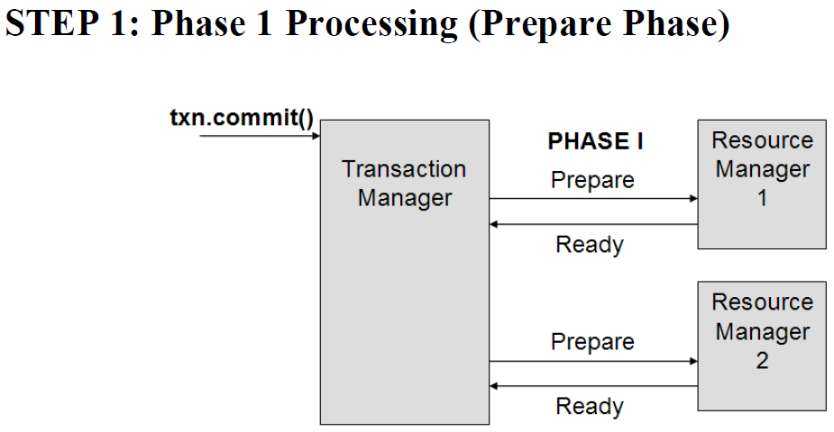
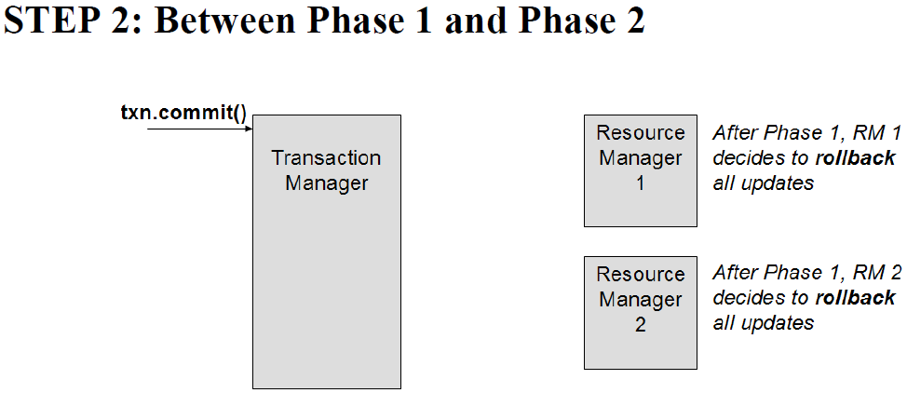
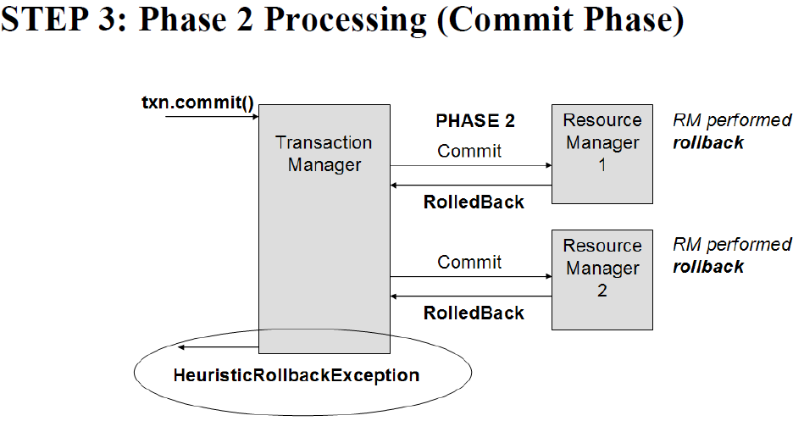
HeuristicRollbackException during commit operation
All the Resource Managers rolled back their work

Slide 15
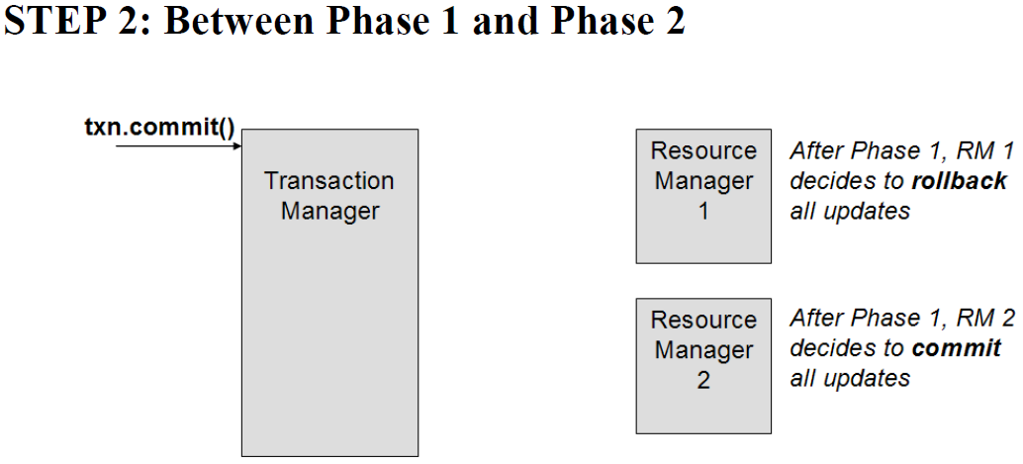
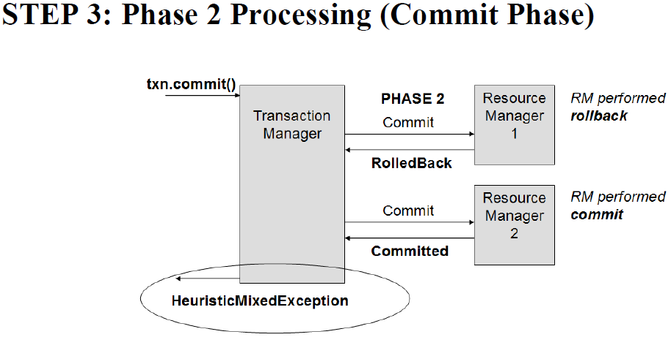
HeuristicMixedException during commit operation
Some of the Resource Managers rolled back their work

Slide 16
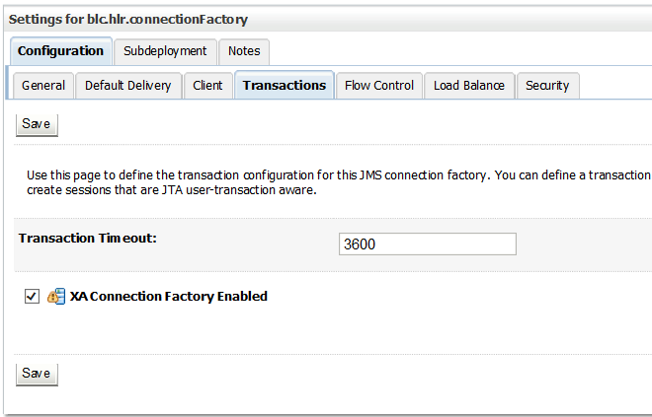
Enabling XA
For JMS
In Weblogic, go to administrative console under Services | JMS Modules | XXX_Module | YYY Connection Factory, Transactions tab, labeled ‘XA Connection Factory Enabled’.
For Database
Use the XA database driver
gemalto_xa_failover.ds
Errors might be experienced
Local transaction errors or Nested transaction errors
Occur when start a new transaction while an XA global transaction is already there
DDL statement is encountered in the Stored Procedure
ORA-02089: COMMIT is not allowed in a subordinate session
Notes:
persistence.xml :
<jta-data-source>gemalto_xa_failover.ds</jta-data-source>
JMS Configuration: https://docs.oracle.com/cd/E13222_01/wls/docs81/jms/fund.html#1023885

Slide 17
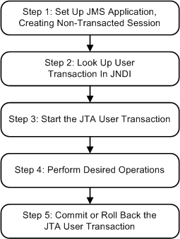
WebLogic JMS XA
https://docs.oracle.com/cd/E13222_01/wls/docs81/jms/trans.html#1025537
Notes:
Step 1: Set Up JMS Application, Creating Non-Transacted Session
Set up the JMS application as described in Setting Up a JMS Application, however, when creating sessions, as described in Step 3: Create a Session Using the Connection, specify that the session is to be non-transacted by setting the transacted boolean value to false.
For example, the following methods illustrate how to create a non-transacted session for the PTP and Pub/sub messaging models, respectively.
qsession = qcon.createQueueSession( false, Session.AUTO_ACKNOWLEDGE ); tsession = tcon.createTopicSession( false, Session.AUTO_ACKNOWLEDGE );Note: When a user transaction is active, the acknowledge mode is ignored.
Step 2: Look Up User Transaction in JNDI
The application uses JNDI to return an object reference to the UserTransaction object for the WebLogic Server domain.
You can look up the UserTransaction object by establishing a JNDI context (context) and executing the following code, for example:
UserTransaction xact = ctx.lookup("javax.transaction.UserTransaction");Step 3: Start the JTA User Transaction
Start the JTA user transaction using the UserTransaction.begin() method. For example:
xact.begin();Step 4: Perform Desired Operations
Perform the desired operations associated with the current transaction.
Step 5: Commit or Roll Back the JTA User Transaction
Once you have performed the desired operations, execute one of the following commit() or rollback() methods on the UserTransaction object to commit or roll back the JTA user transaction.
To commit the transaction, execute the following commit() method:
xact.commit();The commit() method causes WebLogic Server to call the Transaction Manager to complete the transaction, and commit all operations performed during the current transaction. The Transaction Manager is responsible for coordinating with the resource managers to update any databases.
To roll back the transaction, execute the following rollback() method:
xact.rollback();The rollback() method causes WebLogic Server to call the Transaction Manager to cancel the transaction, and roll back all operations performed during the current transactions.
Once you call the commit() or rollback() method, you can optionally start another transaction by calling xact.begin().

Slide 18
Transaction Design Patterns
Client Owner Transaction Design Pattern
Case: require to manage transactions in presentation layer (remote access)
Case: non-remote applications that contain local fine-grained service objects
Domain Service Owner Transaction Design Pattern
Relies on the Declarative Transaction Model
Server Delegate Owner Transaction Design Pattern
Apply to Command Pattern and Server Delegate Design Pattern

Slide 19
Client Owner Transaction Design Pattern
Client Business Delegate
Transaction Owner
If managed by Spring
Framework, then the component
can use declarative transaction
management.
Otherwise, it must use programmatic transactions (WHY?)
For EJB, it must use JTA UserTransaction interface(WHY?)
Domain Service
Must be declarative transaction
Should NOT rollback a transaction when application (checked) exception
TransactionAttributeType: MANDATORY / SUPPORTS

Slide 20
Domain Service Owner Transaction Design Pattern
Client Business Delegate
Does not contain any transaction logic
Does not manage any aspect of transaction processing
Domain Service
Transaction Owner
Course-grained; one request for a single business
TransactionAttributeType: REQUIRED / SUPPORTS

Slide 21
Server Delegate Owner Transaction Design Pattern
Command Pattern
Single object (Command
Processor) own the transaction
Server Delegate Design Pattern
Drawback
The Server Delegate component contains client-based logic
Sometimes, it’s difficult to implement this design pattern:
Client delegate is tightly bound with the web framework being used
Client code contains references to client-based objects (HTTPSession…)

Slide 22
Questions
If one transaction was suspended, will it time out?
Yes, it will.
If DB is not XA, but JMS enable XA, will JMS operation be involved into a global JTA transaction?
What is Command Pattern / Server Delegate Design Pattern / Business Delegate Design Pattern?
ACID?
Atomicity; Consistency; Isolation; Durability

Slide 23
Questions
Will Singleton Service start a transaction?
No
Will Interceptor work in an transaction?
AroundInvoke method invocations occur within the same transaction and security context as the method on which they are interposing.
ViewController won’t start a transaction

